Slide 1
Chapter 3
Modeling
Ronald E. Giachetti, Ph.D.
Associate Professor
Industrial and Systems Engineering
Florida International University

Slide 2
Overview
The purpose of this chapter is to present the concept of modeling – an essential technique for enterprise design
Understand modeling process
Model abstraction, views, and purpose
Differentiate between types of models
Verify and validate models
Explain why model reuse is good
Ronald E. Giachetti
November 8, 2026
Slide <number>

Slide 3

Models
An abstract representation of reality that excludes much of the world’s infinite detail.
  Can be:
    Mathematical model
    Graphical model
    Textual model
    Computer simulation model
The purpose of a model is to reduce the complexity of understanding or interacting with a phenomenon by eliminating the detail that does not influence its relevant behavior.
Model Benefits are:
  Visualization
  Communication of analysis ideas and design ideas
  Design
  Analysis
Ronald E. Giachetti
November 8, 2026
Slide <number>
Notes:
Definitions. These definitions are vague, so it helps to provide some concrete examples.

Slide 4

Model Features
Three model features are:
  Purpose
  Abstraction level
  viewpoint
Ronald E. Giachetti
November 8, 2026
Slide <number>

Slide 5
Model Purpose
A model reveals what its creator believes is important in understanding or predicting the phenomena modeled
This is encoded in the model purpose. The model purpose is what the model is designed to represent
Model purpose should be document, but oftentimes it is not
Ronald E. Giachetti
November 8, 2026
Slide <number>

Slide 6

Mecator’s Projection
Africa is more than 10 times larger than Greenland!
Purpose of model is NOT size accuracy
Ronald E. Giachetti
November 8, 2026
Slide <number>
Notes:
There is a good video segment on Youtube about the TV show West Wing where this was used as part of the show.
The point is that Mercator’s projection is CORRECT FOR ITS PURPOSE: help Europeans navigate to the new world. It is not correct for other purposes such as accurately showing the area of continents.

Slide 7

Peterson’s Project: Area Accurate
Purpose of model is size accuracy
Ronald E. Giachetti
November 8, 2026
Slide <number>
Notes:
This is an area accurate map, odd to look at for most U.S. students who are used to Mercator’s projection. Additionally, there are many other projections of the Earth. The reason there can be so many projections is that there are many different purposes the maps fulfill. There is no single correct map. This is true of systems. Every model should have a stated purpose, and a model designed for one purpose might not fulfill other purposes well.

Slide 8
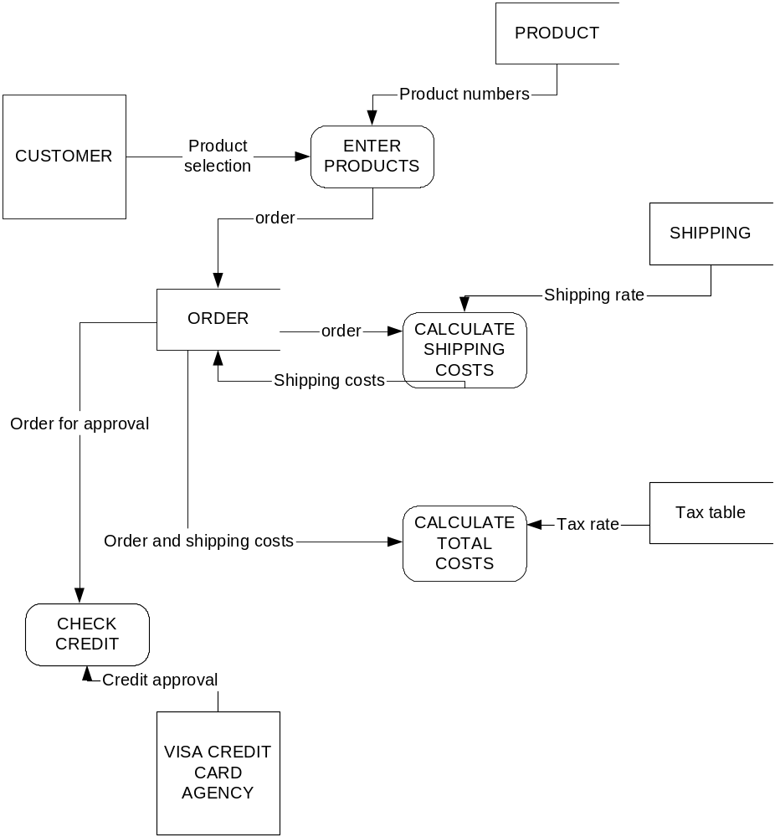
Process Models
In this Data Flow Diagram, the purpose is to show how data flows through the system
Model does NOT show sequence of activities
Ronald E. Giachetti
November 8, 2026
Slide <number>

Slide 9
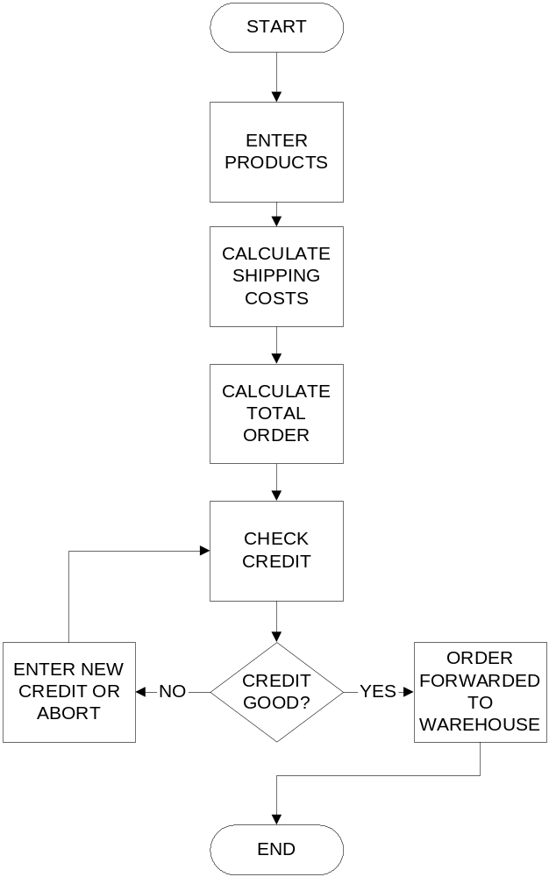
Process Model
In this Flow Chart Diagram, the purpose is to show sequence of activities
Does NOT show how data flows through system.
Ronald E. Giachetti
November 8, 2026
Slide <number>

Slide 10
Two models of the same process
These are both process models of same system, but because each model has a different purpose, it shows different structure
Ronald E. Giachetti
November 8, 2026
Slide <number>
Notes:
This shows the idea of separate purposes for enterprise systems. Both diagrams show the same process, but the models are very different. The reason is each model is built for a different purpose. The flow chart shows sequence of activities, while the DFD shows how data flows in the system.

Slide 11
Modeling Point #1
All models are built with a purpose, the purpose is determined by the model creator
Whether a model is good is based on whether it serves its purpose; generally a model that serves one purpose cannot serve well another purpose (the maps)
Standard models have built in purposes (for example, data flow diagrams versus flow charts)
The model purpose should be made explicit in the model or supporting documentation
Ronald E. Giachetti
November 8, 2026
Slide <number>

Slide 12

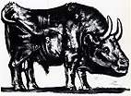


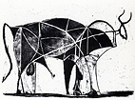

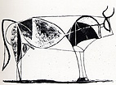
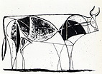
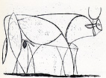
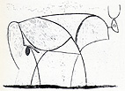

Abstraction
Ronald E. Giachetti
November 8, 2026
Slide <number>
Notes:
IT people, especially when working with UML forget the models are abstractions, they are not the system. The point of this slide is to understand that a given object can be modeled at many levels of detail. Too often students think that the more detail the better. In actuality, the level of detail must match the use of the model. Many analysis models are actually low on detail, while to-be design models have greater levels of detail.

Slide 13
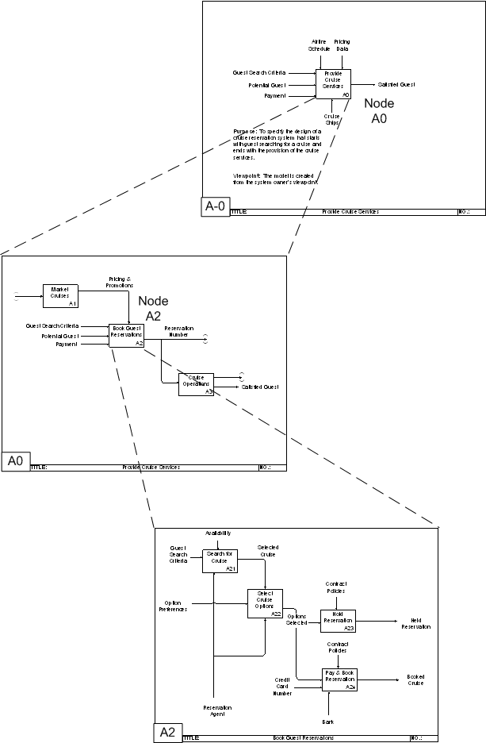
Abstraction in Enterprise Systems
An IDEF0 Model (a common modeling technique, especially on U.S. government projects).
The top level is very abstract, and using the modeling technique, a modeler can add detail iteratively much like Picasso’s bull
Ronald E. Giachetti
November 8, 2026
Slide <number>

Slide 14
Modeling Point #2
Modeling is the ‘art’ of abstraction, knowing what to include in model and what to leave out
Typically, in a single project, you need to convey different amounts of detail, so decomposition whereby different levels of abstraction are shown in different models is a strong technique
More detail does not make a better model, abstraction level needs to be matched to model needs
Ronald E. Giachetti
November 8, 2026
Slide <number>
Notes:
This is from experience.

Slide 15
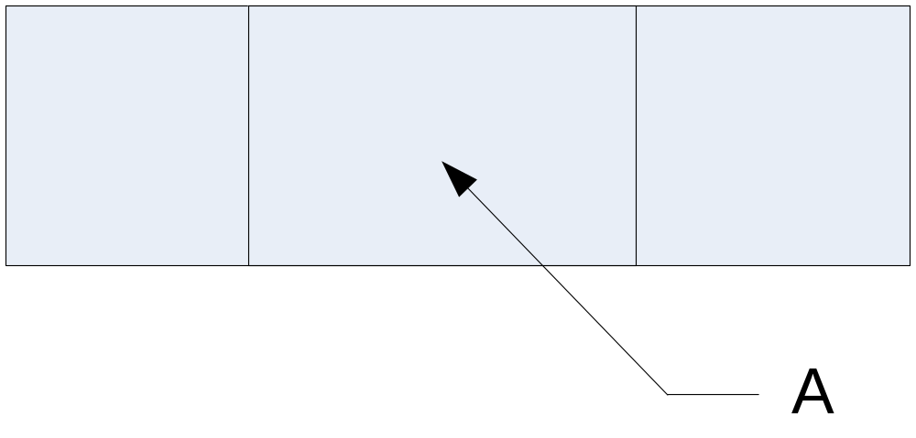
Model Views
Figure 1. Front view of physical object
Ronald E. Giachetti
November 8, 2026
Slide <number>

Slide 16
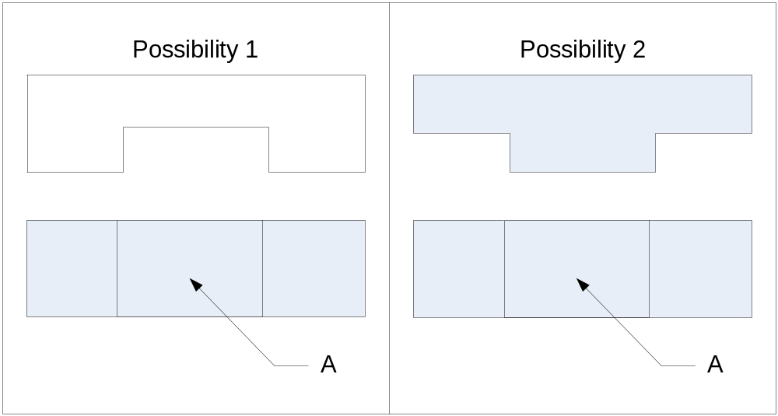
Model Views
Figure 2. Two possible top views for the same front view
Ronald E. Giachetti
November 8, 2026
Slide <number>
Notes:
A real-world object is complex, and we need multiple views to fully understand it. This is true for simple blocks as shown in this slide. It is more true for complex enterprise systems. All reference architectures define multiple viewpoints.

Slide 17
Enterprise System Views
CIMOSA | ARIS | Zachman | Curtis
Function Information Organization Resource | Control Data Function Organization | Data Process I/O | Function Behavior Organization or resource information
Ronald E. Giachetti
November 8, 2026
Slide <number>

Slide 18

Enterprise Views
A Reference Architecture for an ERP system requires the following views:
  Information or Data view – describes the data structure of the entities or objects in the system
  Function View – describes the functions supported by the system (what the system does)
  Process View – describes how the system completes the functions
  Organization View – describes how the enterprise is organized
Ronald E. Giachetti
November 8, 2026
Slide <number>

Slide 19

Modeling Point #3
Systems tend to be complex, our models only abstract limited parts of the entire system (called a view)
  A view is a description of the entire system from the perspective of a set of related concerns. A view is described in one or more models.
You need multiple views to understand the entire system.
  Each view should be orthogonal; i.e. it should show a different perspective
  Views must be consistent!
The view is what you see
The viewpoint is where you look from
Ronald E. Giachetti
November 8, 2026
Slide <number>

Slide 20
Model Features
Purpose – guides reader to understand what the model is intended to show and why
Abstraction – level of detail (vertical)
Views – like abstraction, but from different perspectives (horizontal)
Ronald E. Giachetti
November 8, 2026
Slide <number>

Slide 21
Model Types
Analytical | Deterministic Stochastic
Non-Analytical
Computational (simulation) | Discrete-event Agent-based System-dynamics (continuous)
Ronald E. Giachetti
November 8, 2026
Slide <number>

Slide 22
Model Types
Analytical let you ‘analyze’ since they are based on math – you can solve analytical models
  Prescriptive (how you should operate)
Computational models let you understand system behavior over time
Ronald E. Giachetti
November 8, 2026
Slide <number>

Slide 23
Non-analytical models
Most of systems analysis and design is done with non-analytical models – WHY?
  Much of analysis is understanding ‘as-is’ system
  Low threshold for users to understand
  They work – no quantitative data requirements
HOWEVER, THEY HAVE LIMITATIONS – IN GENERAL QUANTIFICATION IMPROVES ANALYSIS
Ronald E. Giachetti
November 8, 2026
Slide <number>

Slide 24
Verification & Validation
Verification – does the model behave as designed?
Validation – does the model reflect accurately the actual system’s behavior?
Ronald E. Giachetti
November 8, 2026
Slide <number>

Slide 25
V&V
Face Validity – experts review the model and declare it valid
  Considered a weaker form of validity than statistical validation
Validate Boundaries – check boundaries of model
  What happens when there are patient arrival rate exceeds service rate? Waiting time should grow to infinity, if it doesn’t then there is a problem in the model
Check relaxed versions of model
  For stochastic model check what happens for deterministic model equivalent
Check ‘toy problems’ with model
Ronald E. Giachetti
November 8, 2026
Slide <number>

Slide 26
Statistical Validation
State null hypothesis (H_{o}) that the model performance, denoted as x, and the actual system performance, denoted as y, are the same
H_{o} : μ_{x} - μ_{Y} = 0
State the alternative hypothesis
  H₁ : μ_{x} - μ_{Y} ≠ 0
Set confidence interval to 0.05 or 0.1 for the probability of making a Type I error (i.e., rejecting a null hypothesis that is actually true)
Calculate the appropriate test statistic
If you can reject the null hypothesis then accept the alternate hypothesis that the model and the actual system are the same
Ronald E. Giachetti
November 8, 2026
Slide <number>

Slide 27
Enterprise Modeling
Enterprise modeling has to fulfill several requirements to achieve efficient and effective enterprise integration:
  provide a modeling language easily understood by non-IT professionals, but sufficient for modeling complex industrial environments.
  provide a modeling framework which:
    covers the life cycle of enterprise operation from requirements definition to end of life.
    enables focus on different aspects of enterprise operation by hiding those parts of the model not relevant for the particular point of view.
    supports re-usability of models or model parts
Ronald E. Giachetti
November 8, 2026
Slide <number>

Slide 28
Summary
Modeling is an essential skill for enterprise engineering
  Information models → databases
  Process models
  Organizational models
  Many others
Understand basic modeling principles
  Abstraction
  Purpose
  Views
Validation and Verification
Ronald E. Giachetti
November 8, 2026
Slide <number>

Slide 29
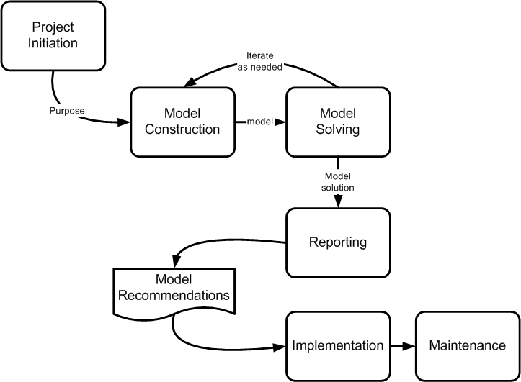
Modeling Process
Ronald E. Giachetti
November 8, 2026
Slide <number>

Slide 30
Model Reuse
Model reuse is when a model can be used again for another project or purpose
Since so much time and effort is put into creating a model, model reuse can cut costs and time for subsequent projects
In practice, it seems there is little model reuse in industry because:
  Models are not maintained, so they become out-of-date
  Models are designed with a particular purpose, and the new project might have different purposes that prevent reuse
Ronald E. Giachetti
November 8, 2026
Slide <number>

